Slide 1

BlueAlpha Data Pipeline

Slide 2
Project Overview
Mission: Transform fragmented, multi-source marketing data into a centralized "Single Source of Truth" for ROI optimization.
Tech Stack:
Orchestration: Apache Airflow
Infrastructure: Docker (Containerized environment)
Ingestion: Python (SQLAlchemy / Pandas)
Storage: PostgreSQL
Transformation: dbt (Data Build Tool)
Key Outcome: Eliminated manual data silos and implemented an automated, analysis-ready marketing mart.

Slide 3
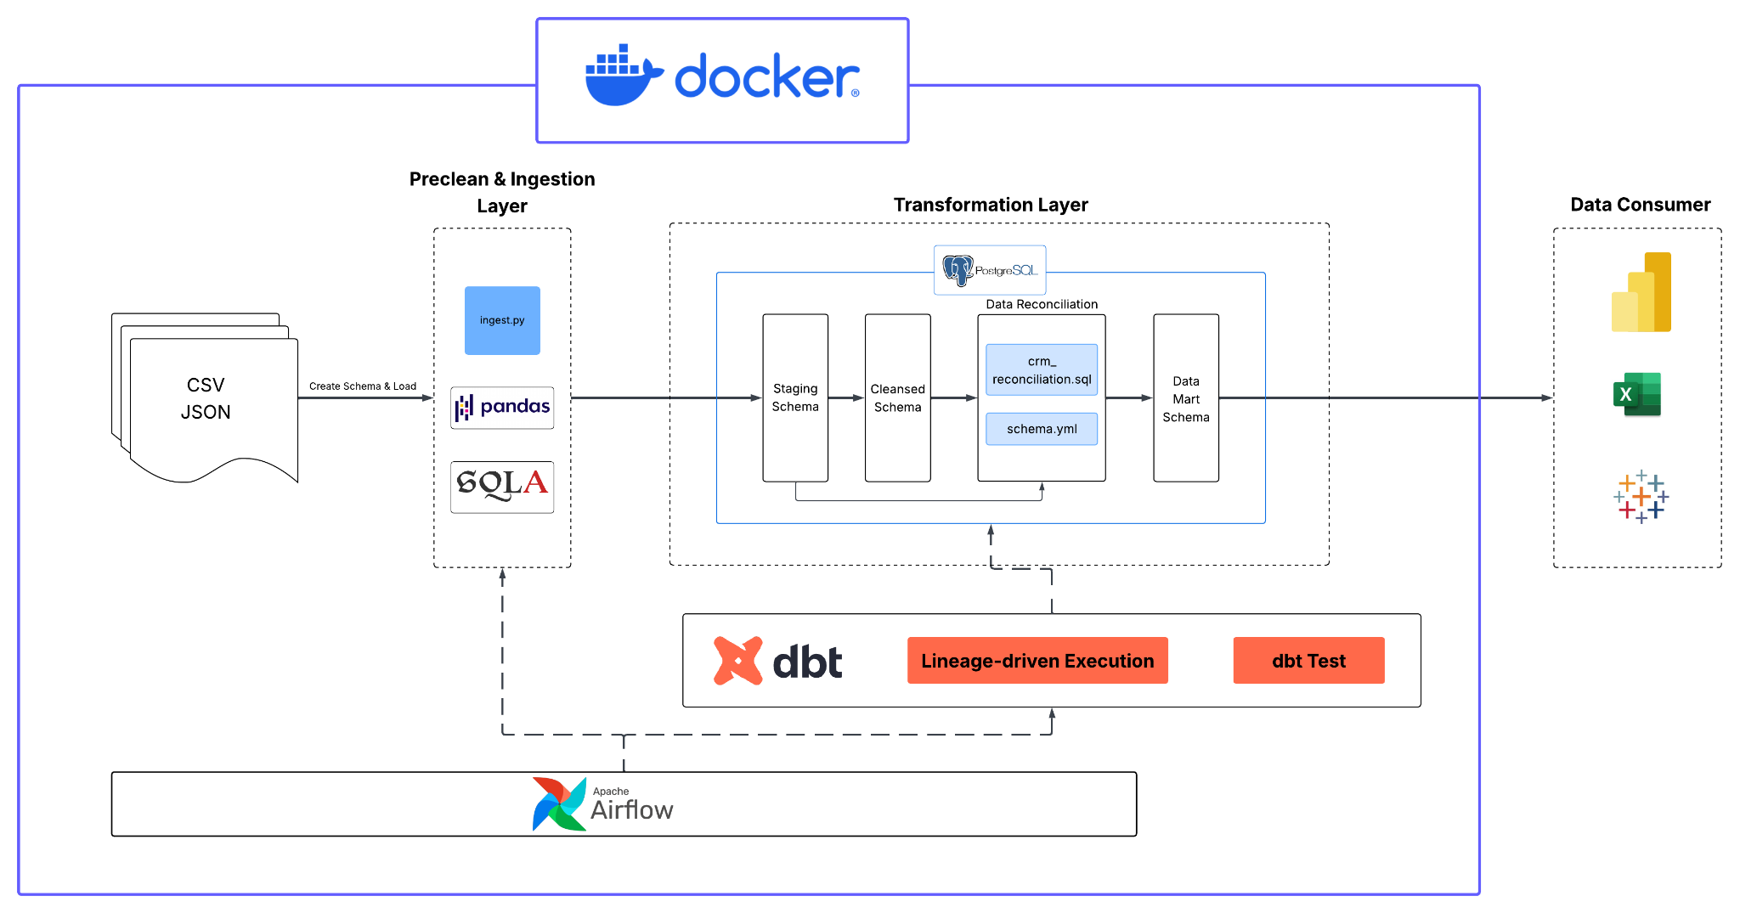
Pipeline Architecture

Slide 4
Ingestion Layer: Turning Raw Chaos into Structured Data
Handling Column Overflow
Normalization & Consistency
Transfer CSV/Json to SQL

Slide 5
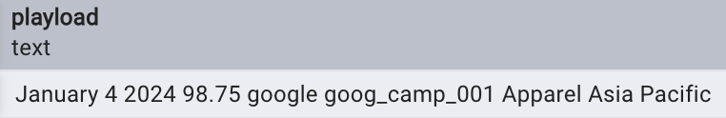
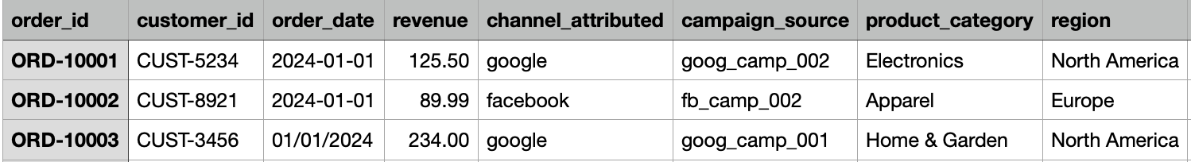
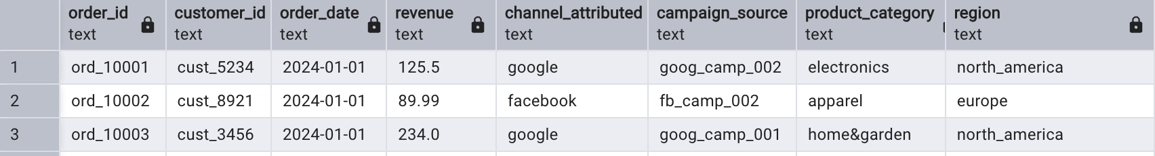
Ingestion Layer - Problems & Solutions
Problems
Solutions

Slide 6
Ingestion Layer - Transfer CSV/Json to SQL
Strategy:
Hybrid Ingestion: Utilized SQLAlchemy and Pandas to orchestrate loading from both flat CSVs (Facebook/CRM) and nested JSON (Google Ads).
Idempotent Execution: Leveraged if_exists='replace' within the pipeline to ensure a consistent data state during every scheduled run.

Slide 7
Transformation Layer(dbt)

Slide 8
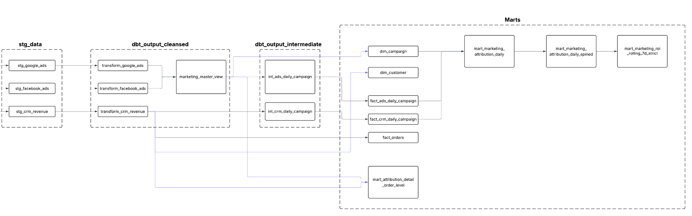
Transformation Layer(dbt)

Slide 9
Cleansed Layer

Slide 10
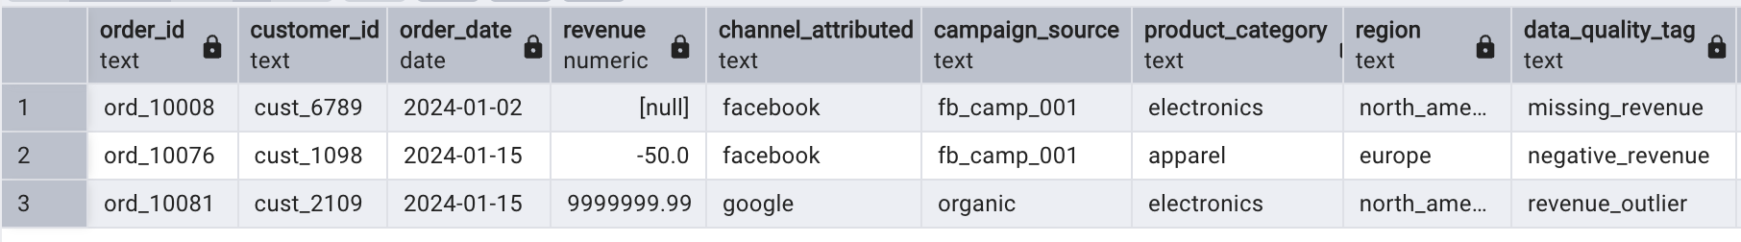
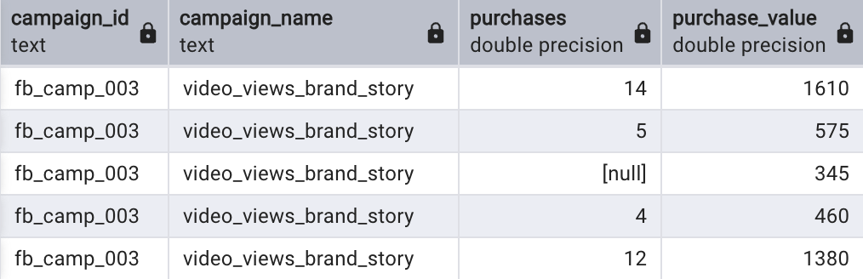
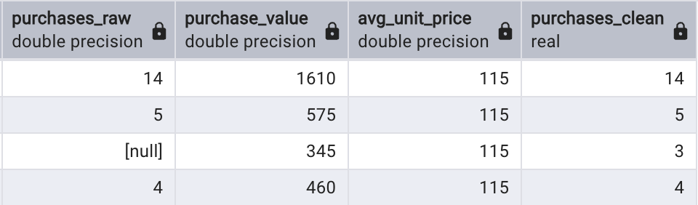
Ingestion Layer - Problems & Solutions
Problems
Solutions

Slide 11
Cleansed Layer: FaceBook Purchases Missing Values
Issue: Facebook reports show purchase_value but NULL purchases.
Solution: Derived unit price (purchase_value / purchases(not null)) at the campaign level to reverse-calculate missing purchase counts in the dbt cleansed layer.
Value: Eliminates data gaps to ensure precise CPA (Cost Per Acquisition) reporting.

Slide 12
Intermediate Layer

Slide 13
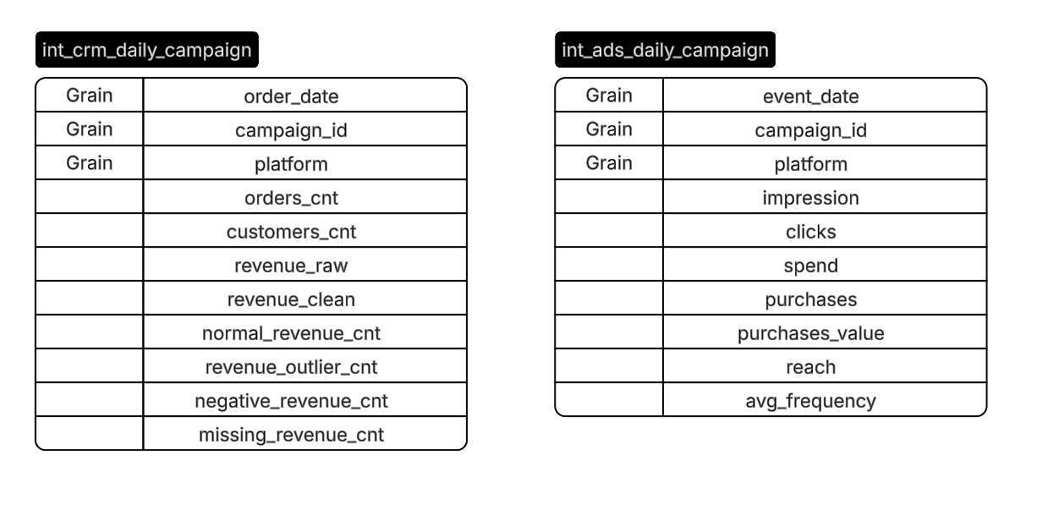
Intermediate Layer
Intermediate Layer
Cleansed
Marts
Standardized Multi-Source Grain
Unified Dimensions: Both Ads and CRM data are aligned to a single, consistent grain: date, campaign_id, and platform.
Cross-Source Joinability: This alignment enables seamless downstream joining between ad spend (platform-side) and realized revenue (CRM-side) for ROI analysis.

Slide 14
Marts Layer

Slide 15
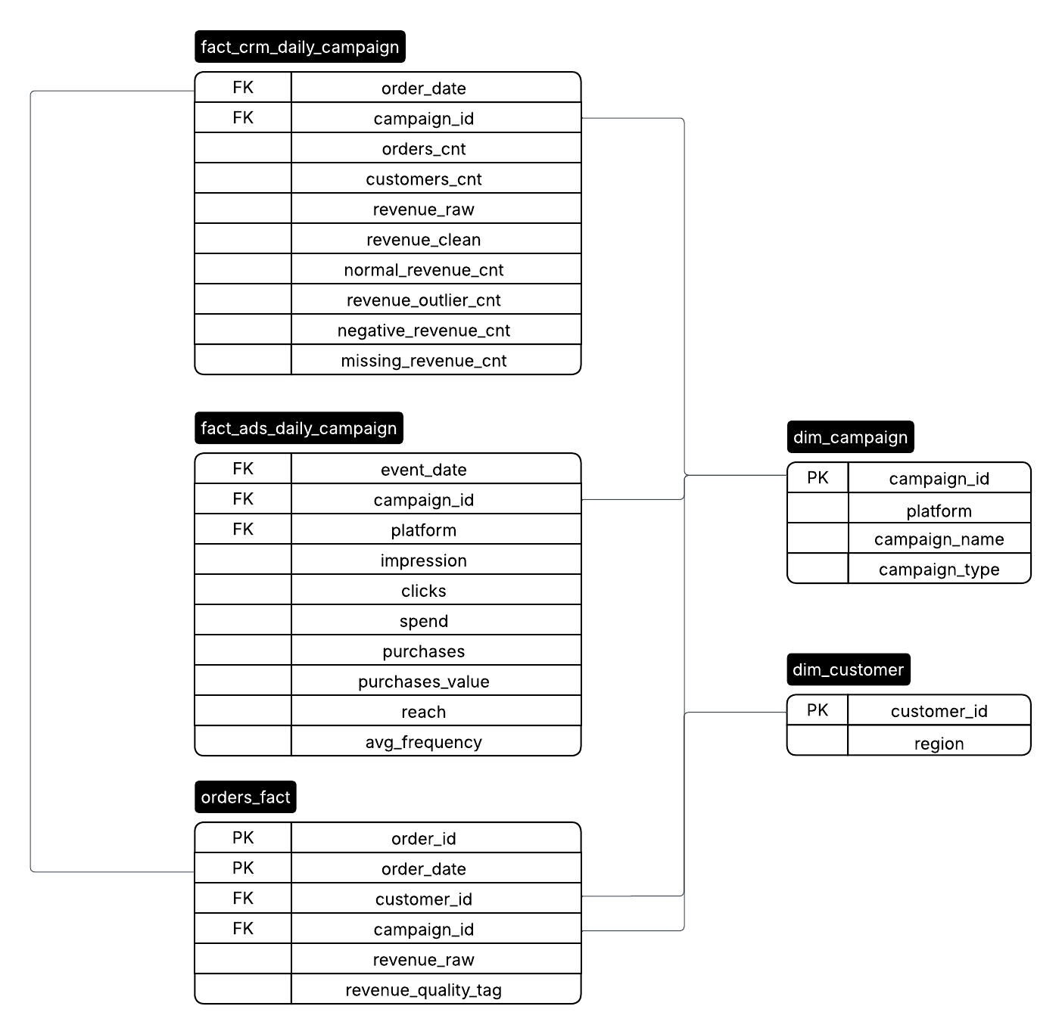
Marts Layer: Data Modeling
Star Schema Architecture: Developed a high-performance Star Schema that decouples metrics (Fact tables) from descriptive attributes (Dimension tables) to optimize BI tool performance.
Unified Fact Tables:
Marketing Performance: Consolidated fact_ads_daily_campaign and fact_crm_daily_campaign at a standardized grain (Date, Campaign, Platform) for seamless ROI analysis.
Granular Orders: Maintained an orders_fact table to allow for transactional auditing and revenue quality tracking.
Shared Dimensions (Conformed Dimensions):
dim_campaign & dim_customer: Centralized campaign and customer metadata to ensure consistent reporting across all business units.

Slide 16
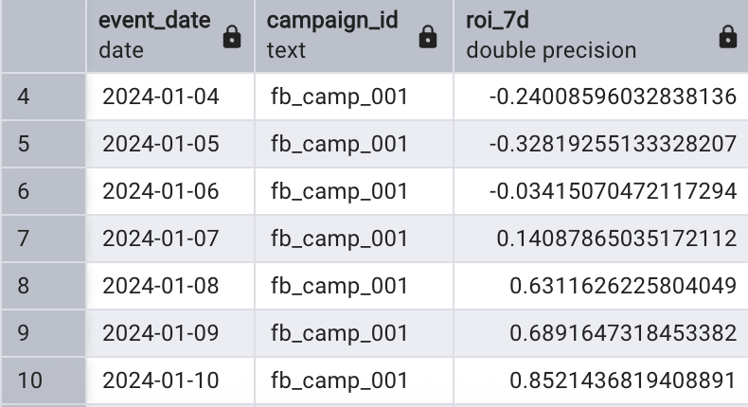
Marts Layer: Attribution Lag
Issue: Some customers convert several days after initial ad exposure, leading to "orphan" revenue in CRM that cannot be linked to ad spend.
Solution: Provide both Daily and Rolling 7 Day views. This helps smooth short-term volatility and better reflects long-term performance.
Value: Captures delayed conversions, providing a true reflection of campaign long-term performance.

Slide 17
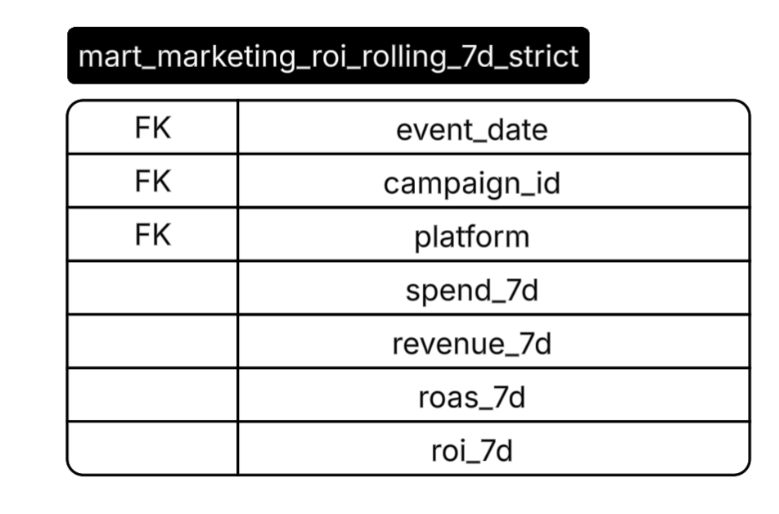
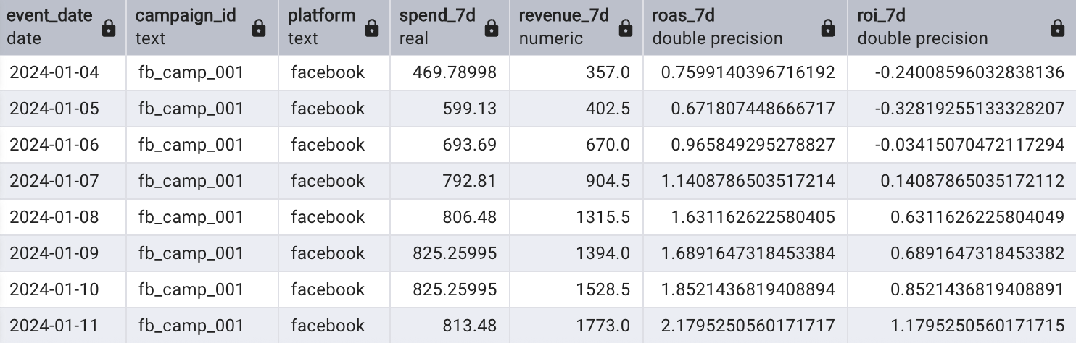
Marts: ROI Tables

Slide 18
Data Quality Strategy
Double Layer Data Cleaning
Revenue Reconciliation
dbt Test

Slide 19
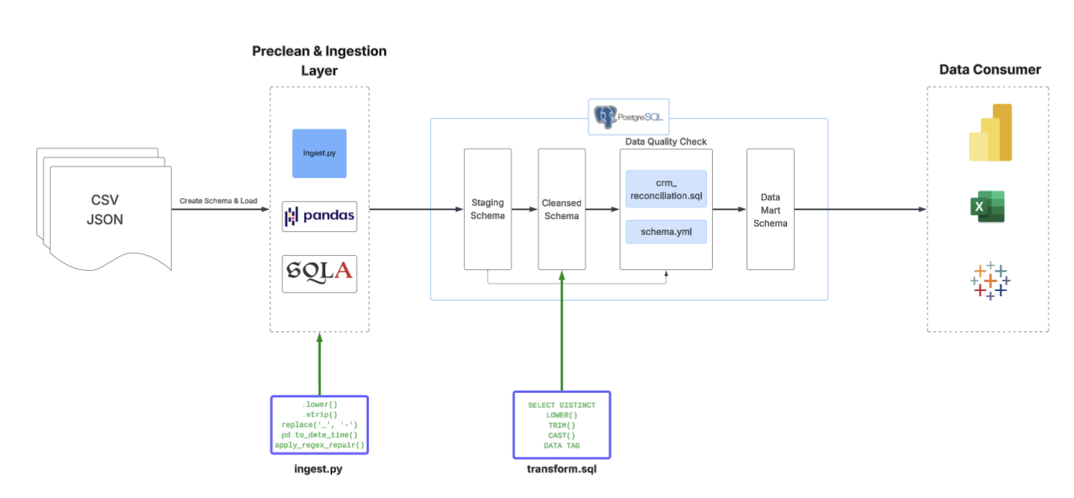
Data Quality Strategy - Double Layer Data Cleaning

Slide 20
Data Quality Strategy - Revenue Reconciliation
Staging
Cleansed
Deduplication Logic:
By subtracting identified duplicates from raw revenue via SELECT DISTINCT and set logic, the pipeline ensures that SUM(raw) - SUM(dedup) = SUM(dup).
Value:
Guaranteed data integrity where every dollar is accounted for, categorized, and verified.
SUM(raw_revenue)
SUM(dedup_revenue)
SUM(dup_revenue)

Slide 21
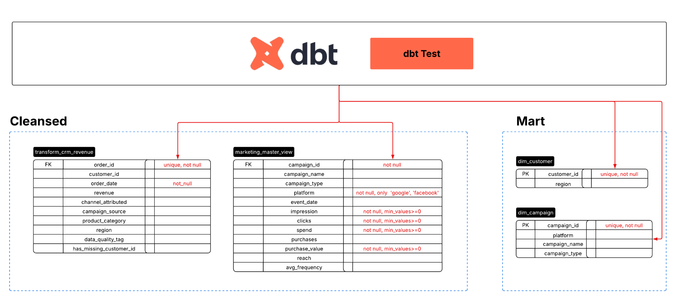
Data Quality Strategy - dbt Test

Slide 22
Trade Offs & Things to improve with more time
Trade Offs
Full Refresh: Currently uses if_exists='replace' and full dbt refreshes. This is simple and consistent for current data volumes but lacks scalability for millions of rows.
Outlier Processing: Outliers are tagged but still processed by the DB. Ideally, these should be intercepted at the ingestion layer.
Things to improve with more time
Lakehouse Architecture: Migrate to Delta Lake for unified batch/stream processing; Time Travel.
CI/CD: Automate deployment pipelines with integrated unit and integration testing(dbt cloud).
Advanced Validation: Cross-source checks (e.g., ensuring Ad Platform purchase_value doesn't exceed CRM total_revenue).
Alerting: Deploy real-time monitoring for pipeline failures and significant revenue anomalies.
Business Logic Utils: Decouple transformation logic into reusable modules to improve maintainability.

Slide 23
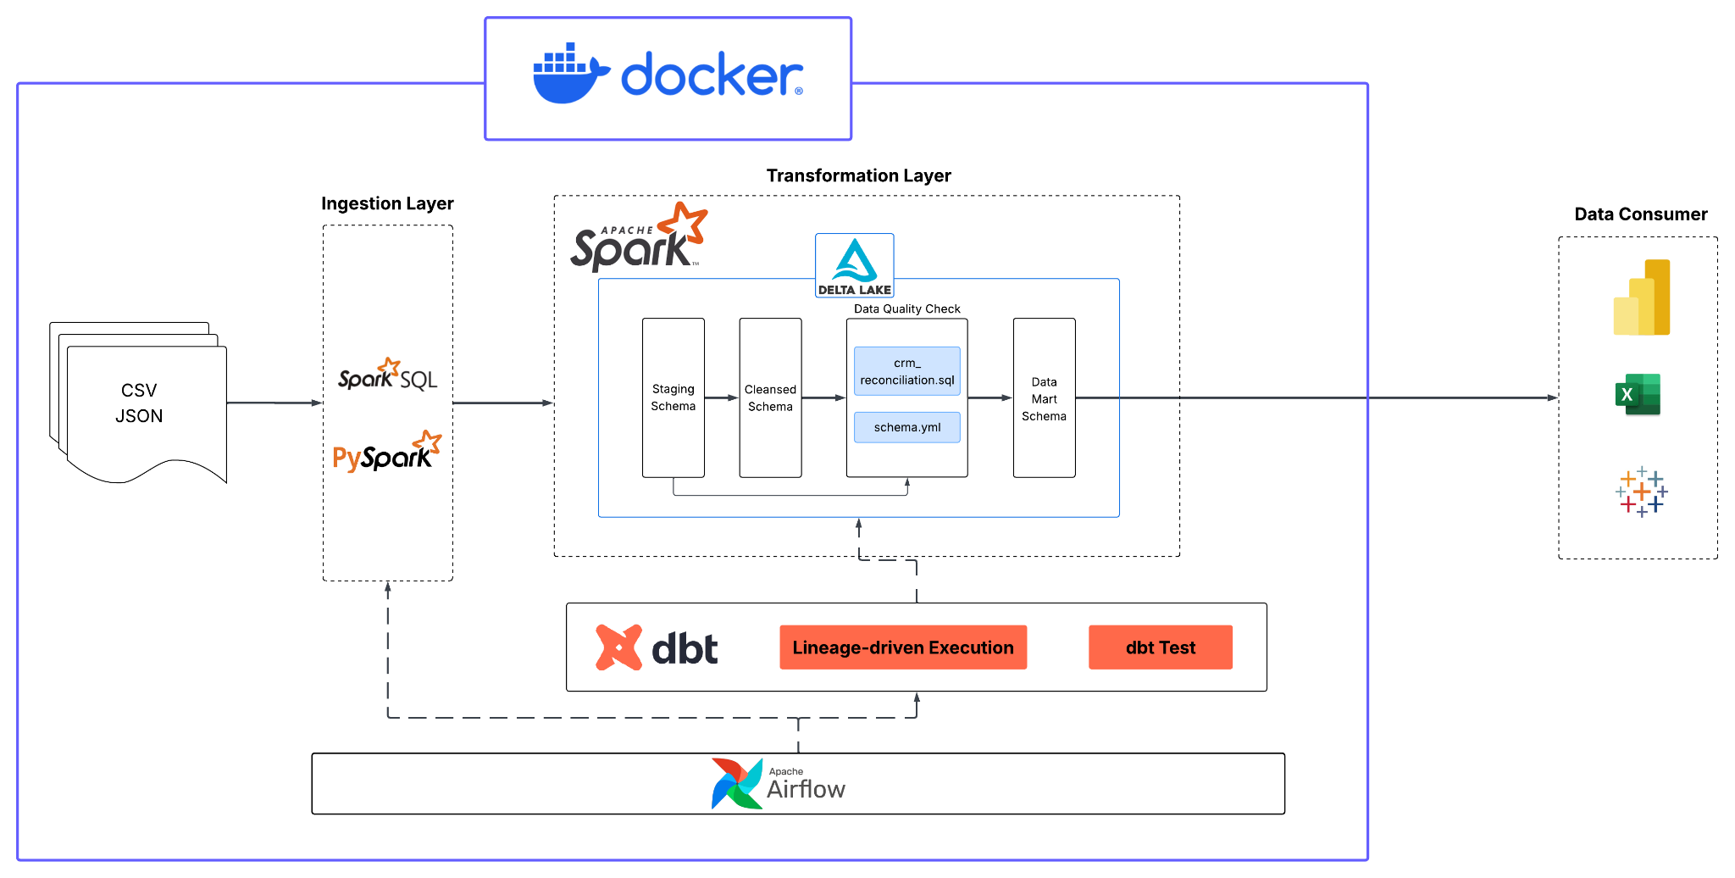
The Ultimate Version

Slide 24
Q&A

